Slide 1
Newsletter August- September 2026
Updates & News

Slide 2
Releases & Launches
Newly Updated Beauty Catalogue
Newly Updated Wave & Wonders
Complete Eco-Friendly Launched
Special Home Essential Edition
Updated Pets Essentials
New Personalised & Gifts Catalogue Launched
Full Christmas Collection Finalised

Slide 3
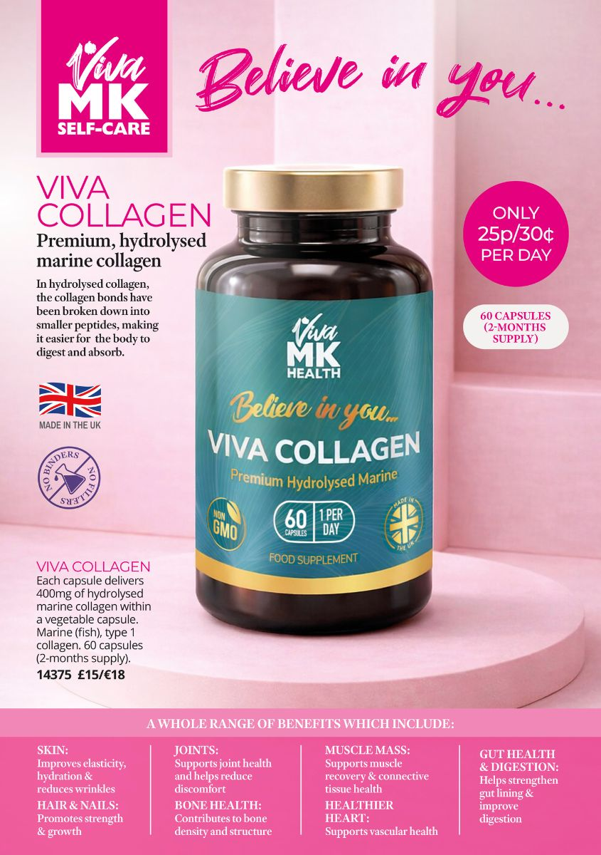

VivaMK Self-care
Beauty, Health & Wellness all in one catalogue

Slide 4
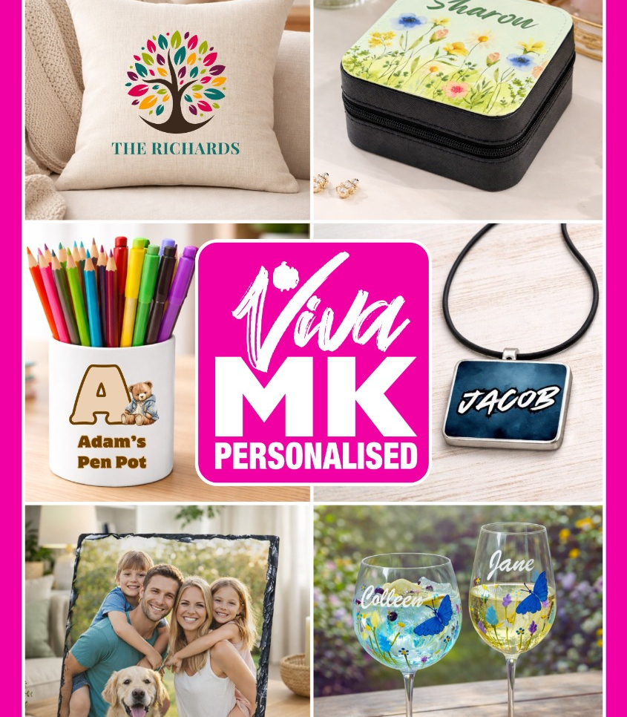
Vivamk personalised
Vast range of gifts & daily essentials - all personalised

Slide 5

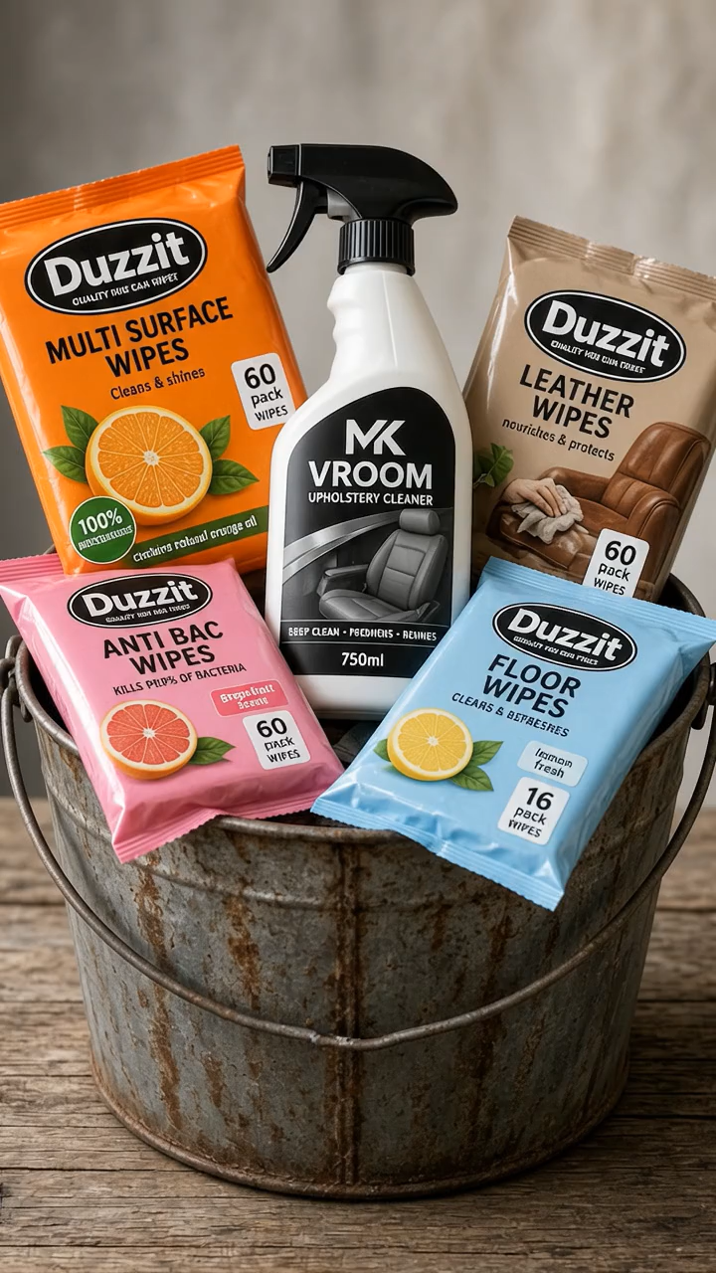
VivaMK home essentials
Popular products summarised in one catalogue

Slide 6
Expansion program
There is no better time than now to work with us.
We are heading into the Christmas Sales our products are all ready to be shipped
Recruitment is ongoing and the development cycle is ready to spring
More redundancies are expected, more people need to work extra or are looking for incomes
Economy is tougher than ever
Only joint collaboration is persevering

