Slide 1
Q4 MARKET ANALYSIS
Newsletter June – July 2026

Slide 2
Agenda
New Products
New Markets
New Audience
Retail & Distribution
Customer Satisfaction

Slide 3

NAVIGATE THE FUTURE
New Products
More for Pets
More for Outdoors
Father's Day
Teacher's Day
New Beauty Additions
New Household Accessories

Slide 4
CURRENT MARKET ANALYSIS
The wide spectrum of markets require continues progression
Market segments need newcomers
Market segments require improvements
Market needs new customers and partners
Market requires replication and creation
Market is the bread & butter of growth

Slide 5

UNLOCKING NEW HORIZONS
Market
expansion

Slide 6
New Audience
Brands need careful consideration to reach the right market
New markets to be established
Integration of networking with existing platforms
Communication extension
Retention of customer loyalty
Product Supply Direct Sales
Q3
Audience
Q4
Product Placement
Q1
Communication

Slide 7
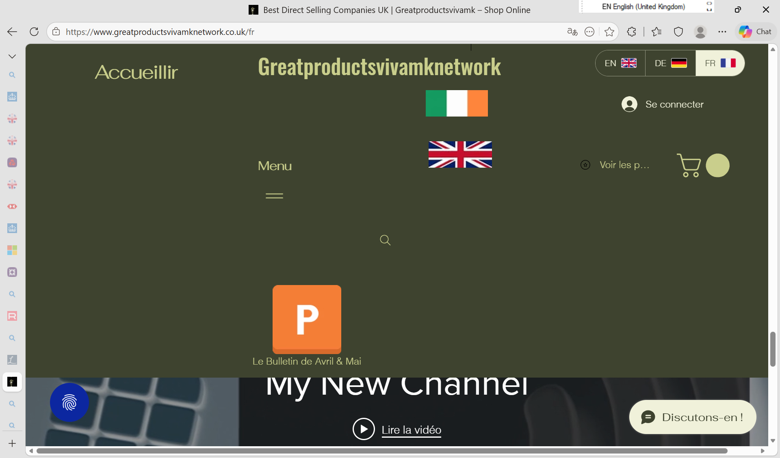
Retail & distribution
Increasing local customer base and retaining customers
Growing online presence through audience expansion
Growing B2B sales
Establishing European Market
Networking for products and starters in the forthcoming months

Slide 8

Customer
Satisfaction
Low return and refund rate
Good word of mouth referrals
Returning Sales

Slide 9

Thank you
Margit enzenmuller
00441483 456098
margit@greatproductsforyou.co.uk
https://www.greatproductsforyou.co.uk

