Slide 1

Newsletter December/January 2026

Slide 2
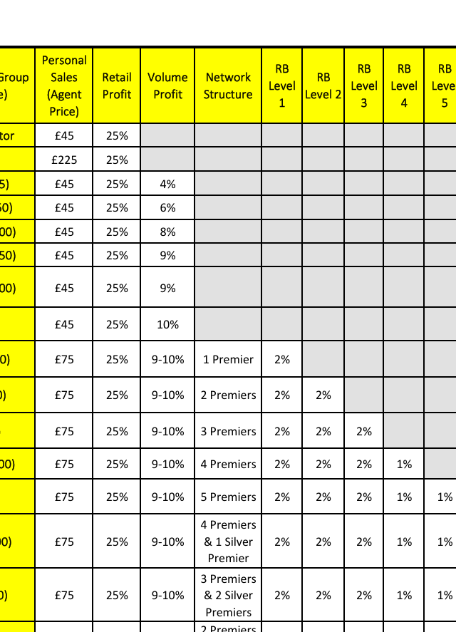
AGENDA
Introduction
Building confidence
Engaging the audience
Visual aids
Final tips & takeaways

Slide 3
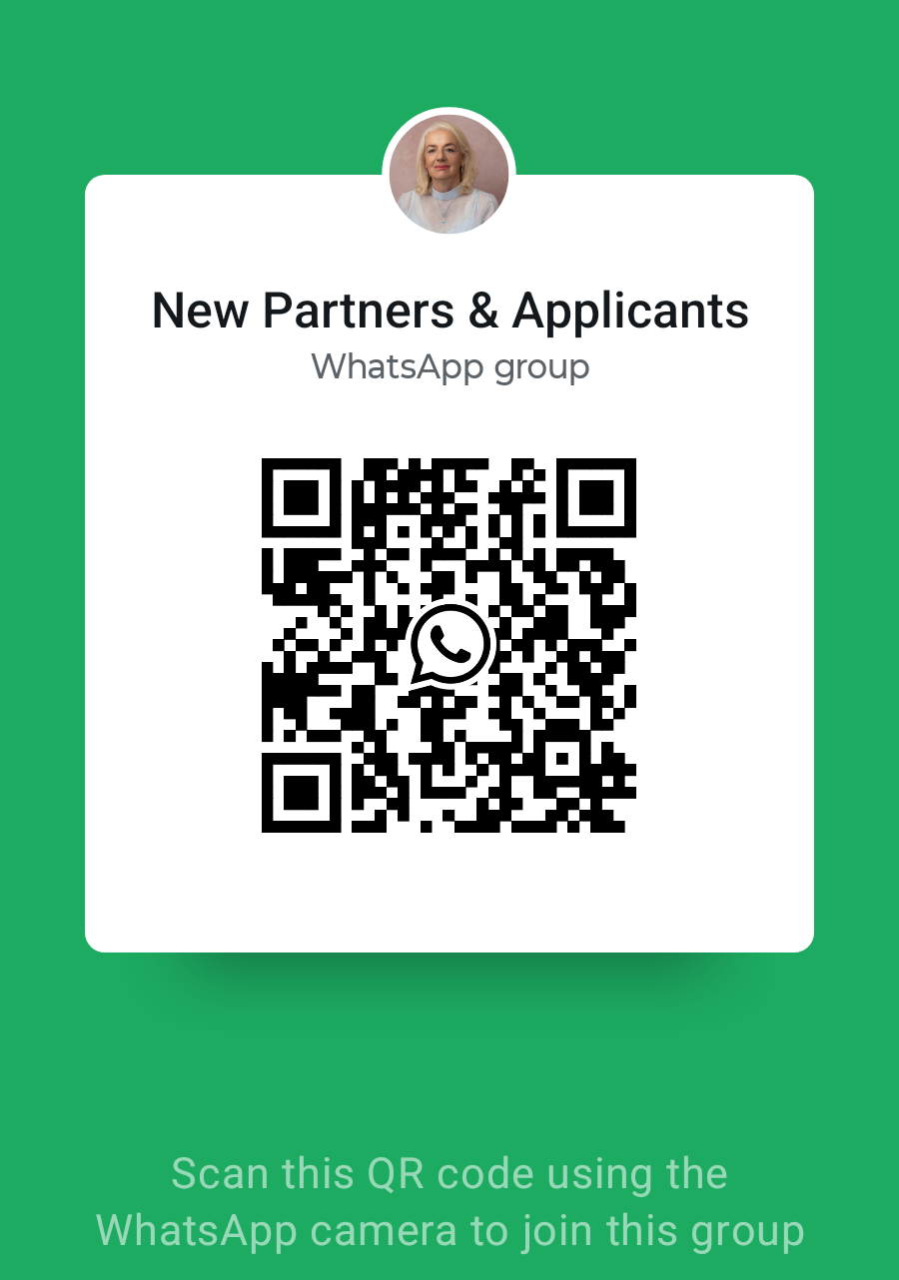
THE POWER OF COMMUNICATION

Slide 4

Building of Customer Base
Applying the team's tools for lead generation
Be consistent in showing & presenting products
Be open ears for recommendations & feedback
Work in a team & gain leadership skills

Slide 5

ENGAGING THE AUDIENCE
Engage Customers with relevant news & deals
Promote Customer Choices
Publish relevant information for networking & recruitment
Support product categories with relevant news & product key points
Always maintain company policies
Network with family, friends, customers & businesses

Slide 6
New Products arriving in january 2026
Winter Warmers to keep you cozy
More vegan & green products for health & beauty
New year sale 2026
Inspiring products for home, gifts & outdoors

Slide 7

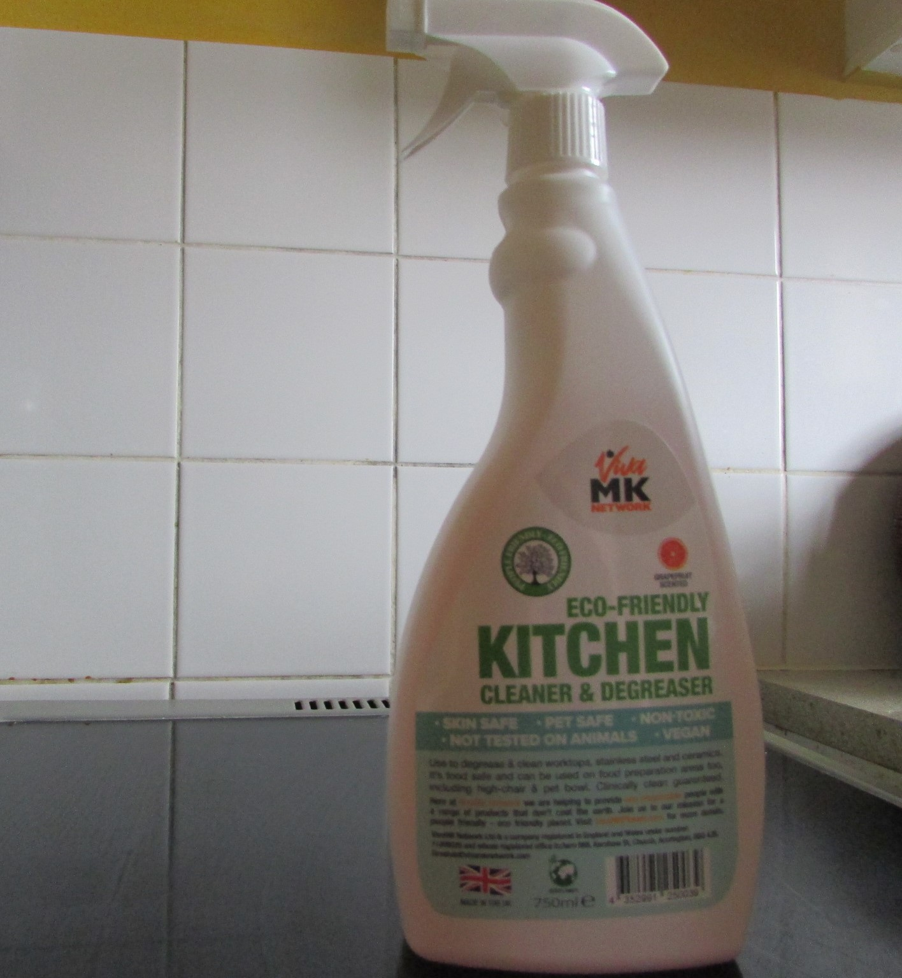
Popular products vegan & self-care

Slide 8

FINAL TIPS & TAKEAWAYS
Let the customers & prospects arrive into 2026 with buzz and incentives.
Build your own recruitment plan filled with milestones and achievements
Be available for new prospects and team members
Consider new methods for lead generation, implementing spark moments & reiterate final result
Invest in working strategies for maximum results with time & money

Slide 9

THANK YOU
Margit Enzenmuller
01483456098
Margit@greatproductsforyou.co.uk
www.greatproductsforyou.co.uk

