Slide 1
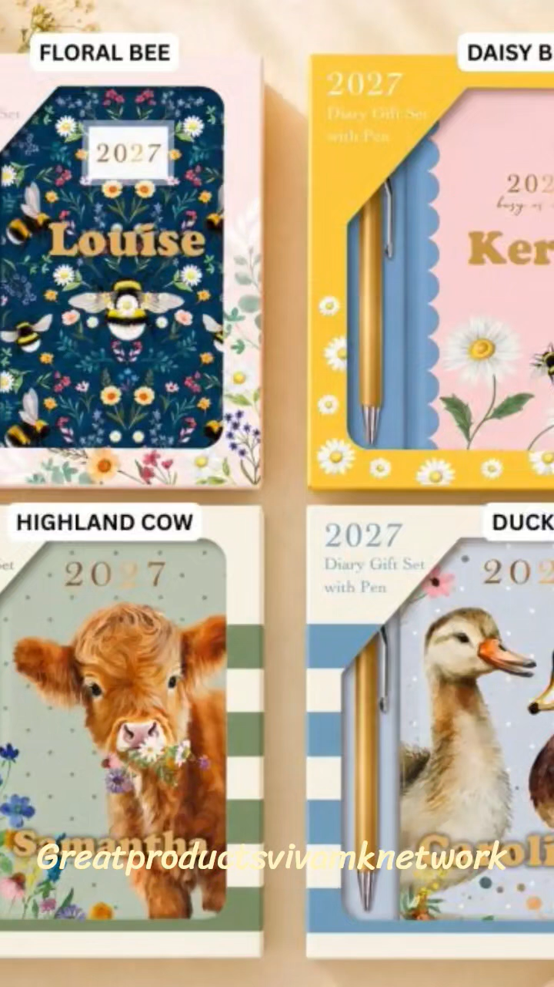
Great Products For You
Product Showcase Catalogue

Slide 2
Welcome
The Christmas Launch back in September has proven to be a full success for distributors. Items sell fast and product choice is popular.
New launch of winter warmers is showing good results as winter is anticipated to be very cold. Many customers will supply themselves to reduce heating costs and concentrate on essentials.
New products in house proud to cook and dine for the festive period.
Personalised gifts for adults & children will be a best seller

Slide 3
Product Categories
Home & Cleaning
Beauty & Personal Care
Personalised Gifts
Pet Products
Garden & Outdoor
Seasonal

Slide 4
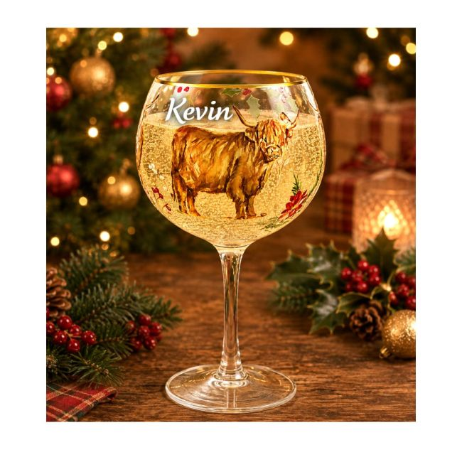
Featured Product: Highland Coo Gin Glass
Celebrate the festive season in style with our Christmas Glassware Range. Available in 3 festive designs and 3 glassware options: stemless, wine, and gin glass. Each piece features a charming design and a delicate gold rim for a touch of elegance. Perfect for entertaining or gifting, this collection combines festive charm with timeless style. Hand wash. Comes gift boxed. Stemless: H12cm, 500ml. Wine: H23cm, 400ml. Gin: H22cm, 500ml. Personalise in white vinyl, with up to 15 characters
Add product images here

Slide 5
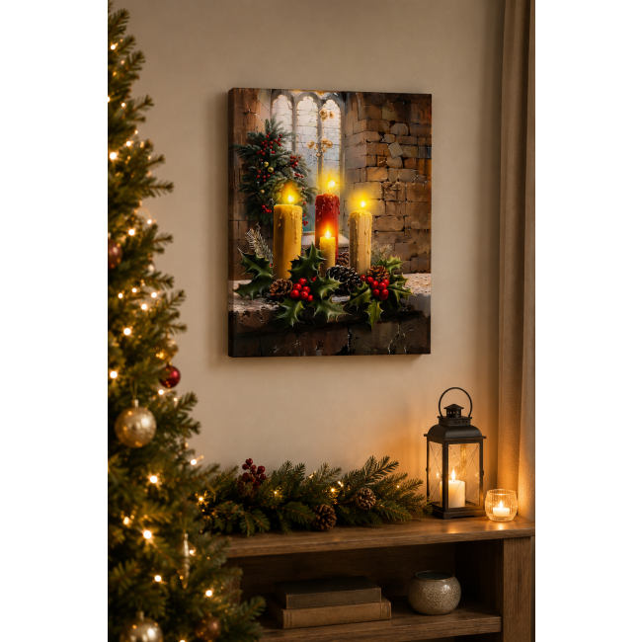
Bestsellers Collection
Bring warmth and ambience to your home with this beautiful LED Christmas canvas. Featuring four glowing candles surrounded by festive holly and berries, the LED flames can be turned on or off with a gentle touch or by blowing towards the candles, just like the real thing. A stunning seasonal decoration for walls, shelves or mantelpieces. H40 x W30cm. Requires 2 x AA batteries (not included).
Add product images here

Slide 6
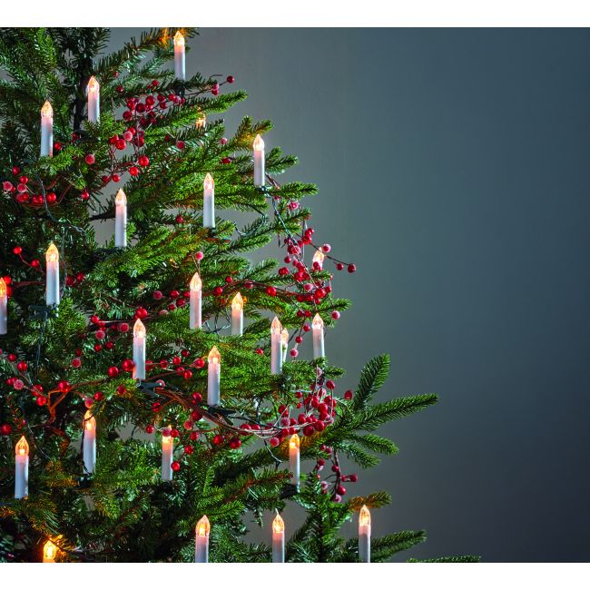
Customer Favourites
Add product images here
Create a warm and nostalgic festive feel with this set of 30 ivory flicker-effect candles. The discreet green wiring and clips seamlessly blend into your décor. Use on a tree or garland. Comes boxed. Warm white. Plastic. Auto timer, 8 hours on, 16 hours off. Mains operated. 5m to first light. 7m lit length. Space between each candle: 25cm. Total length: 12.25m. Each candle: L8cm. Compatible with Magic Wand available on 91080 for only £20.

Slide 7
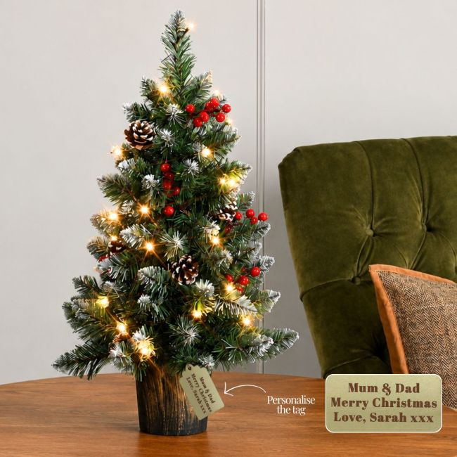
New Arrivals
Bring the magic of the holidays into your home with this beautifully decorated tabletop tree. Featuring lush green branches with snow dusted tips, it's adorned with realistic berries and pinecones for a timeless festive look. The natural effect potted base complements any décor, while warm white LED lights create a cosy ambience with multiple lighting modes. 63 tips. 25 warm white LEDs. 8 lighting modes. Gift boxed. Plastic. Requires 3 x AA batteries (not included). H60cm. Includes a wooden personalised gift tag, simply tie it around the base using the supplied string. Engrave wooden tag with up to 3 lines, max. 20 characters per line.
Add product images here

Slide 8
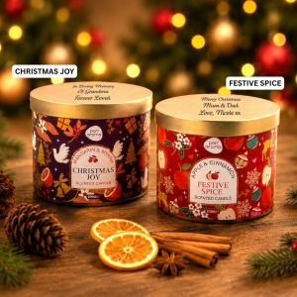
Bundle Offers
Bring the magic of Christmas into your home with our beautifully crafted festive scented candles. Available in two delightful seasonal fragrances: Christmas Joy blends the warmth of mandarin and myrrh, while Festive Spice fills the room with the comforting aroma of apple and cinnamon. Perfect for creating a cosy atmosphere, gifting loved ones, or adding a touch of festive charm to any space. Each is 230g. 30 hours burn time. Engrave the lid with up to 3 lines, max. 20 characters per line.
Add product images here

Slide 9
Why Buy From Us
Buy directly online
https://greatproducts.vivamknetwork.co.uk
Call/whatsapp 07807317371 free delivery in Guildford UK
https://www.greatproductsforyou.co.uk
https://www.greatproductsvivamknetwork.co.uk
TikTok Shop Greatproductsvivamknetwork
eBay Shop Greatproductsvivamknetwork

Slide 10
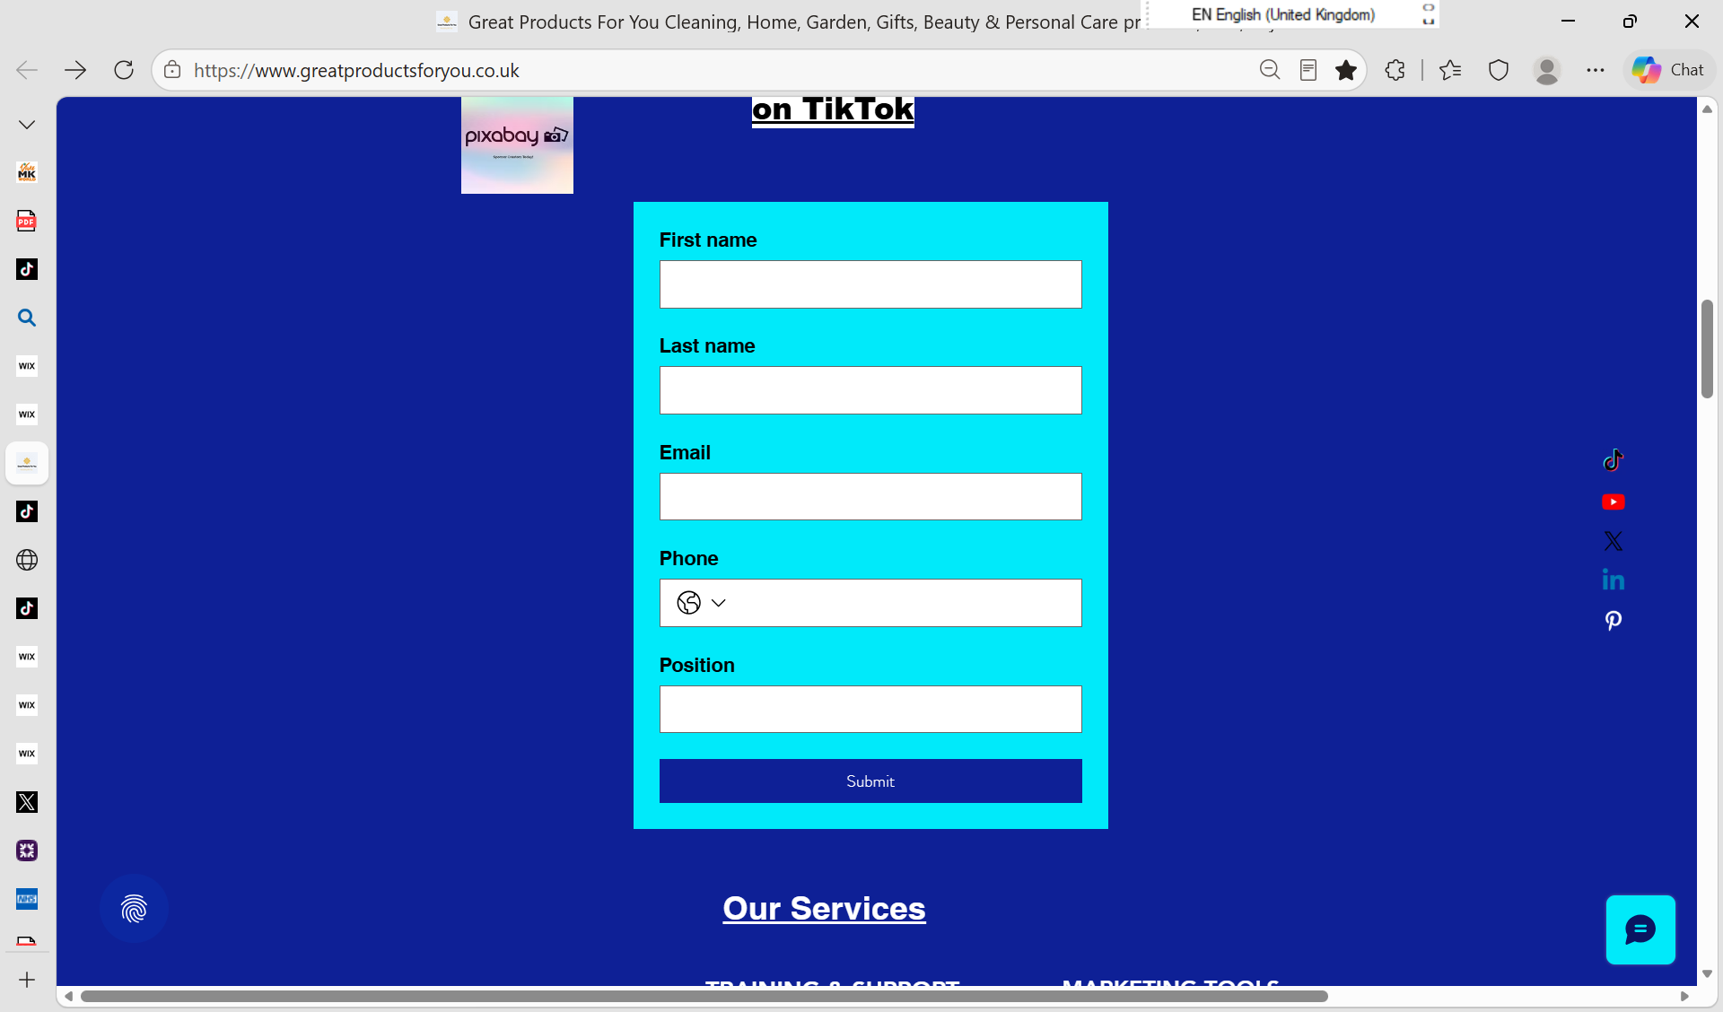
https://www.greatproductsforyou.co.uk
Register for an account with discounts
Start Selling
Fill in Application Form

