Slide 1

Products Just Rise Higher & Higher
Margit Enzenmuller

Slide 2

ABOUT US
About
Great Products For You
Retail & Sales of most essential products to satisfy demands in the UK & Ireland. Recruitment to shape your future in business and personal.

Slide 3

PROBLEM
Problem
Economic Constraints
COSTS
Fighting rising prices and sustainable living
Prices which reflect the sales development
CUSTOMERS
USABILITY
Customer acquisition in the long term
Both plans for customers & new recruits have to mirror business goals.
FINANCIALS
Plans to last. Implementation of agile structures to maintain growth.

Slide 4

PRODUCT OVERVIEW
Christmas collection
New Pet-tacular Collection
Christmas Ideas & Christmas Essentials
Everything for your pet's wellbeing
Living Spaces & Little Faces
Green living
Coming soon with more green products and big health benefits
The very best for your home

Slide 5

PRODUCT BENEFITS
Fantastic Health Benefits
Reasonable Prices & Discounts
Complete Customer Satisfaction
Benefits

Slide 6

BUSINESS MODEL
Product
Recruitment
Leadership
Sourced & Competitive
Creating pipelines for people to make them aware of one of the best opportunities on the market
Applying the latest leadership skills

Slide 7


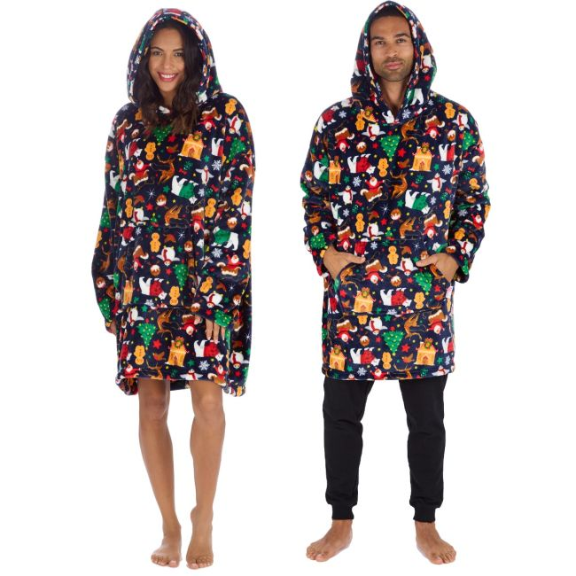

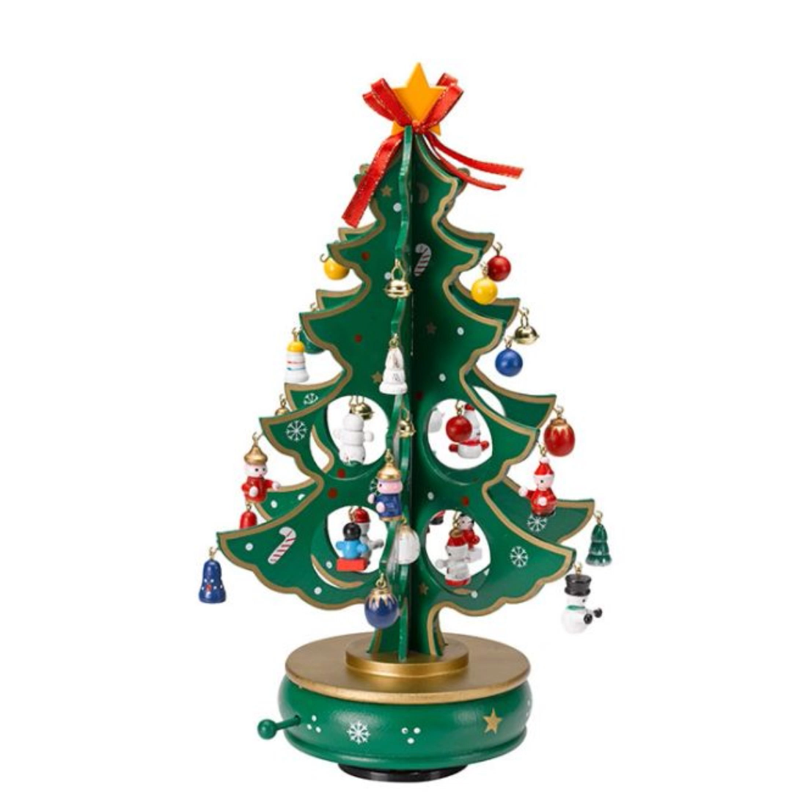

Product Highlights
OCT 20XX
Roll out product to local businesses to help establish the product
Release the product to the general public and monitor stock market trends
Gather feedback from the financial community to expand availability of the product

Slide 8


SUMMARY
Before the End of the Year we have 100s of new products launched reaching from home, health & beauty to daily essentials.
As ever we keep prices affordable & maintain a good availability.
New Year preparations to meet the headquarters and launching incentives for a better payment plan.
Register Today

Slide 9

Thank You
Margit Enzenmuller
01483456098
margit@greatproductsforyou.co.uk
www.greatproductsforyou.co.uk

